Slide 1

SignScribe
Raspberry Pi Based Sign Language Interpreter
ELECTRONICS IN SERVICE TO SOCIETY PROJECT - GROUP 1

Slide 2

AIM
Our project aims to break down communication barriers faced by the deaf and hard of hearing community through the development of a Raspberry Pi 4B-Based Sign Language Interpreter. By leveraging technology, we seek to provide real-time sign language interpretation, promoting inclusivity and accessibility. Additionally, integrating text-to-speech functionality aims to further assist the visually impaired, enhancing overall accessibility.

Slide 3

OBJECTIVE
The primary objective of this project is to develop a Sign Language Interpreter using a Raspberry Pi 4B with a USB camera. The project aims to contribute to the United Nations Sustainable Development Goals (SDGs), specifically targeting SDG 4 - Quality Education and SDG 10 - Reduced Inequalities.
By leveraging the capabilities of the Raspberry Pi 4B and a quality web-camera, the team seeks to create a technological solution that can interpret and translate sign language gestures in real-time, to text as well as speech.
Through the development of this Sign Language Interpreter, the team aspires to empower individuals with hearing and visual impairments and foster a more inclusive society where communication is accessible to all.

Slide 4
KEY FEATURES
Real-time Gesture Recognition: The system utilizes a USB camera to capture and interpret sign language gestures in real-time, striving for efficient and effective communication, while acknowledging ongoing enhancements for further precision and responsiveness.
User-Friendly Interface: The interpreter includes a user-friendly interface displaying the interpreted signs, making it accessible to both individuals with hearing impairments and those without prior knowledge of sign language. Additionally, the integrated text-to-speech (TTS) functionality, accessible via wired earphones, enhances usability for all users, fostering inclusive communication.
Integration with Educational Resources: The interpreter is designed to integrate seamlessly with educational materials, providing a valuable tool for deaf students and educators. It can be used in classrooms, online courses, or other educational settings.

Slide 5
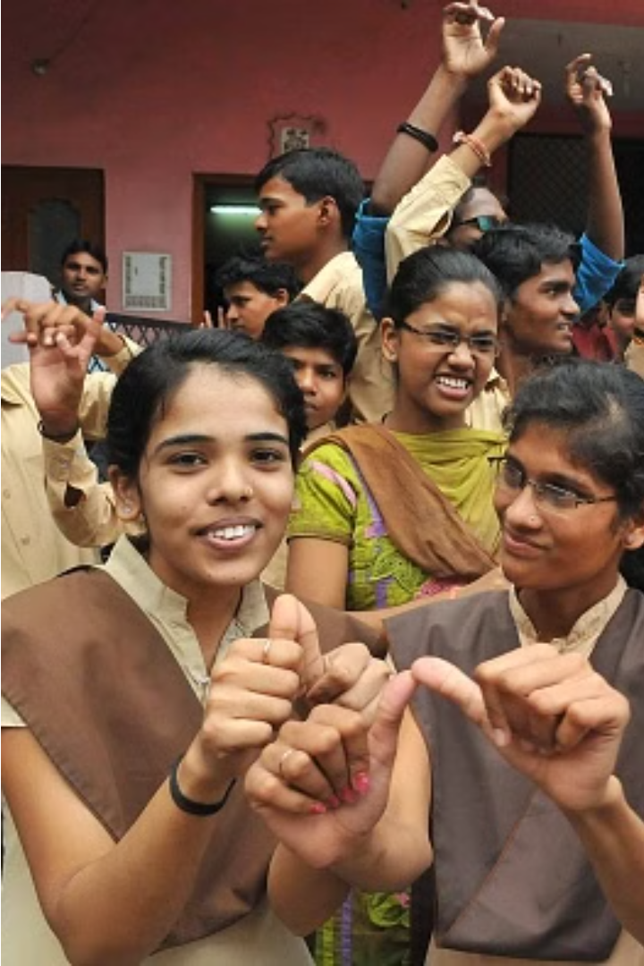
1. ALIGNMENT WITH SDG 4 - QUALITY EDUCATION
Access to Spoken Information: Enables inclusive education by providing access to spoken content.
Facilitates Communication: Promotes dialogue with non-signers, fostering collaboration.
Enhances Language Skills: Supports language development through exposure to spoken language.
Promotes Independence: Empowers students to engage with spoken content autonomously.
Prepares for Real-World: Equips learners to navigate situations requiring spoken communication.

Slide 6
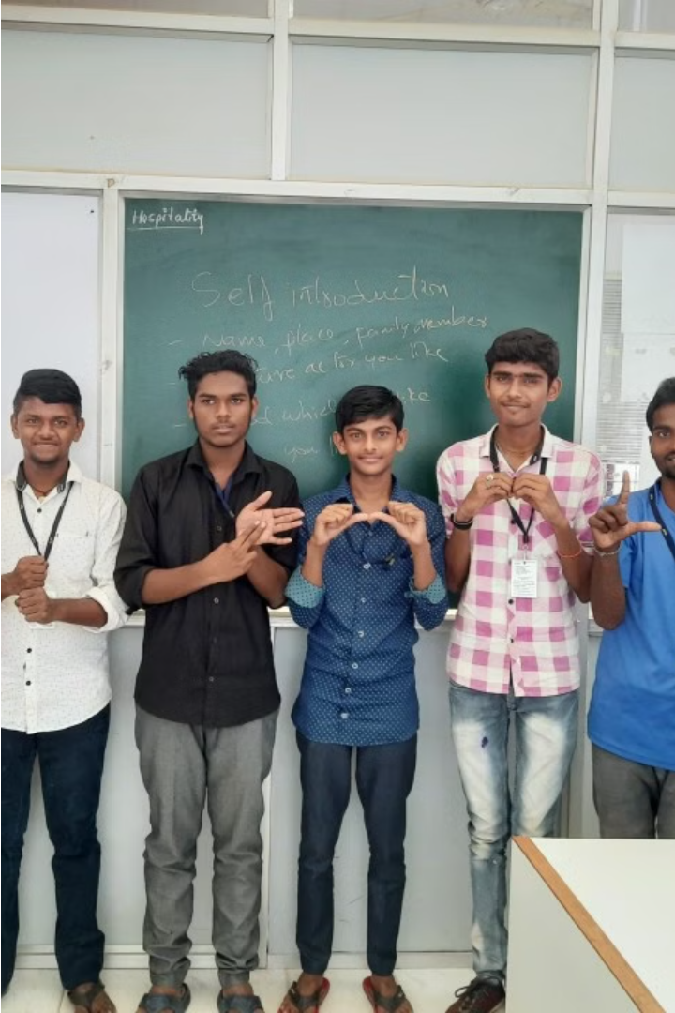
2. ALIGNMENT WITH SDG 10 - REDUCED INEQUALITIES
Equal Access: Provides fair access to spoken content, reducing barriers.
Inclusive Dialogue: Fosters inclusive communication, reducing social gaps.
Empowered Skills: Enhances language abilities, leveling opportunities.
Self-Reliance: Promotes independence, bridging educational disparities.
Real-World Readiness: Prepares for spoken communication, fostering social equality.

Slide 7
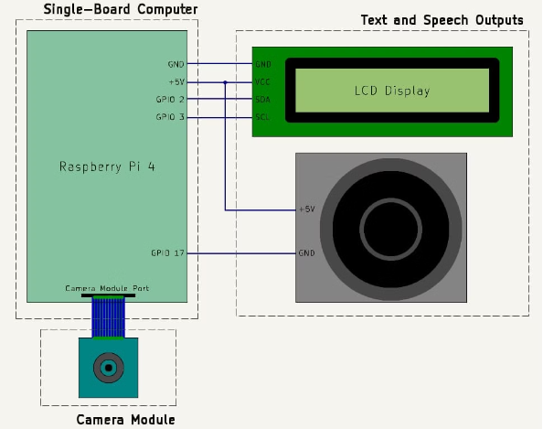
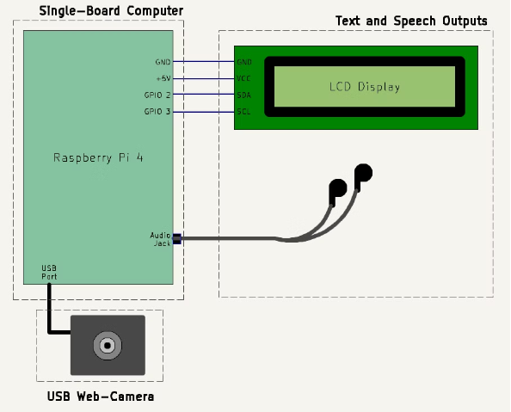
SCHEMATIC
Old Layout
New Layout

Slide 8
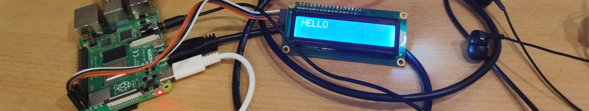
IMPLEMENTATION
1
Raspberry Pi Setup
Initial setup of Raspberry Pi 4B and installation of suitable environment for code implementation.

Slide 9
2
Modelling
Creation of dataset for Indian sign language gestures.
Importing necessary libraries for data processing.
Specifying the path for storing images.
Designing the model structure, utilizing a pose-based deep learning model with LSTM for sequential data processing.
Training the model and evaluating its performance on test data, achieving an accuracy rate of 85-90%.

Slide 10
3
Testing
Importing required libraries for implementation of Mediapipe.
Implementation of pose estimation using Mediapipe for real-time gesture recognition.
Integration of the trained recognition model with the system.
Interfacing the LCD display with Raspberry Pi to visually display text output.
4
User Interface
Installation of necessary libraries for I2C LCD display interfacing.
Interfacing the LCD display with Raspberry Pi to visually display text output.
Installation of necessary libraries for text-to-speech (TTS) functionality.
Writing code to convert text output into speech, enabling users to hear the interpreted signs through wired earphones connected to the audio jack.

Slide 11
COMPONENTS
Raspberry Pi 4B
Web-Camera
Wired Earphones
LCD Display
The web-camera is crucial for SignScribe, capturing real-time video for precise gesture recognition. Integrated with the Raspberry Pi 4B, it accurately interprets intricate hand movements, ensuring seamless translation.
The LCD display is vital for SignScribe, showing interpreted gestures. It makes communication accessible to all, enhancing usability for both deaf and hearing users.
The Raspberry Pi 4B serves as the core of SignScribe, providing the computational power and connectivity needed for real-time video processing, gesture analysis, and text/audio output generation.
The wired earphones in SignScribe provide audible feedback by transmitting interpreted sign language into spoken language, enhancing accessibility for both deaf and hearing communities, fostering inclusivity and understanding.

Slide 12
COST REPORT
Sr. No.
Component
Cost
1
Raspberry Pi 4 Model B with 4 GB RAM
4649
2
I2C LCD Display
230
3
USB Web-Camera
1850
4
Wired Headphones
50
TOTAL
6779

Slide 13
CONTRIBUTORS
Yash Bhavnani (211060035):
Responsible for setting up the Raspberry Pi: Installation of the OS and the necessary libraries required for project implementation.
Successfully identified and resolved issues related to interfacing the Camera Module 3 with Raspberry Pi.
Contributed in developing code for Text-to-Speech conversion on Raspberry Pi.
Researched about interfacing the LCD Display with Raspberry Pi and assisted with it.
Worked on interfacing the Web Camera with Raspberry Pi by downloading necessary packages.
Flavia Saldanha (211021007):
Responsible for conceptualizing the project idea and collaborated with the team to refine it.
Assisted in the initial setup of Raspberry Pi, including OS installations.
Installed necessary libraries to support project functionalities.
Developed a dataset for 10 gestures, achieving an accuracy rate of 90%.
Worked on interfacing the LCD display, ensuring it effectively presented the text format of interpreted gestures.
Implemented thresholds for probability to optimize display output.

Slide 14
Samruddhi Patil (211061032):
Found and curated relevant sample dataset and resources crucial for model training, ensuring comprehensive coverage of gesture variations.
Developed and fine-tuned the machine learning model, adjusting parameters to boost accuracy and performance.
Contributed to debugging of interfacing issues between Raspberry Pi and the Camera module.
Successfully interfaced jack earphones with Raspberry Pi, converting textual interpretations into clear audio output.
Participated in collaborative problem-solving sessions, offering insights and solutions to technical challenges.
Sakshi Rathod (211061010):
Contributed in the initial setup of Raspberry Pi, including OS installations.
Developed and tested a dataset for 10 gestures, achieving an accuracy rate of 80%.
Assisted in interfacing the LCD display with Raspberry Pi ensuring it effectively presented the text format of interpreted gestures.
Assisted in interfacing jack earphones with Raspberry Pi, converting textual interpretations into clear audio output.

Slide 15

Thank You!

